Slide 1

Introduction to PHP

Slide 2
PHP Introduction
The PHP Hypertext Preprocessor (PHP) is a programming language that is a widely-used open source general-purpose scripting language that is especially suited for web development and can be embedded into HTML.

Slide 3
PHP Introduction
> PHP is a server-side scripting language
> PHP scripts are executed on the server
> PHP supports many databases (MySQL, Informix, Oracle, Sybase, Solid, PostgreSQL, Generic ODBC, etc.)‏
> PHP is open source software
> PHP is free to download and use

Slide 4
PHP Introduction
> PHP runs on different platforms (Windows, Linux, Unix, etc.)‏
> PHP is compatible with almost all servers used today (Apache, IIS, etc.)‏
> PHP is easy to learn and runs efficiently on the server side
> PHP offers many advantages;
it is fast,
stable,
secure,
easy to use and open source (free).

Slide 5
PHP Introduction
Instead of lots of commands to output HTML (as seen in C or Perl), PHP pages contain HTML with embedded code that does "something" (like in the next slide, it outputs "Hi, I'm a PHP script!").
The PHP code is enclosed in special start and end processing instructions <?php and ?> that allow you to jump into and out of "PHP mode."

Slide 6
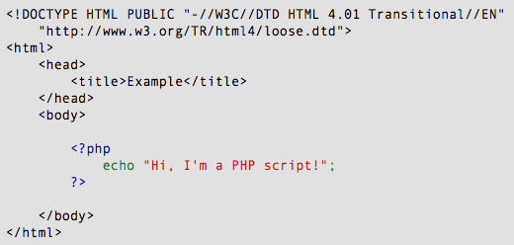
PHP Introduction

Slide 7
PHP Introduction
PHP code is executed on the server, generating HTML which is then sent to the client. The client would receive the results of running that script, but would not know what the underlying code was.
A visual, if you please...

Slide 8
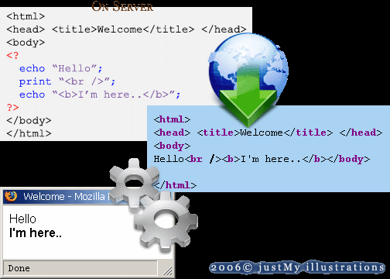
PHP Introduction

Slide 9
PHP Getting Started
On windows, you can download and install XAMPP. With one installation and you get an XAMPP webserver, database server and php.
https://www.apachefriends.org/download.html
Online Resources
http://www.w3schools.com/php/default.asp
https://www.tutorialspoint.com/php/index.htm

Slide 10
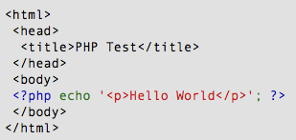
PHP Hello World
Above is the PHP source code.

Slide 11
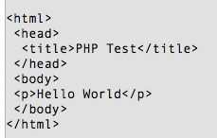
PHP Hello World
It renders as HTML that looks like this:

Slide 12
PHP Hello World
This program is extremely simple and you really did not need to use PHP to create a page like this. All it does is display: Hello World using the PHP echo() statement.
Think of this as a normal HTML file which happens to have a set of special tags available to you that do a lot of interesting things.

Slide 13
Echo
The PHP command ‘echo’ is used to output the parameters passed to it
The typical usage for this is to send data to the client’s web-browser
Example
echo “hello World!”;

Slide 14
Echo example
<?php
$foo = 25; // Numerical variable $bar = “Hello”; // String variable
echo $bar; // Outputs Hello
echo $foo,$bar; // Outputs 25Hello
echo “5x5=”,$foo; // Outputs 5x5=25
echo “5x5=$foo”; // Outputs 5x5=25 echo ‘5x5=$foo’; // Outputs 5x5=$foo
?>
Notice how echo ‘5x5=$foo’ outputs $foo rather than replacing it with 25
Strings in single quotes (‘ ’) are not interpreted or evaluated by PHP
This is true for both variables and character escape-sequences (such as “\n” or “\\”)

Slide 15
Print Command
can only output one string, and returns always 1.
<?php
$foo = 25; // Numerical variable $bar = “Hello”; // String variable
print $bar; // Outputs Hello
print $foo,$bar; // Parsing error
print “5x5=”,$foo; // Parsing error
print “5x5=$foo”; // Outputs 5x5=25 print ‘5x5=$foo’; // Outputs 5x5=$foo
?>

Slide 16
Print Command
Change the print statements to the following:
print “line 1\n”;
print “line 2”;
Now you see the following on the web page:
line 1 line 2
HTML displays the output on the web page as one line. If you
want HTML to display two lines, you must use a tag, such as the
<br> tag. So, change the PHP end-of-line special character to an
HTML tag, as follows:
print “line 1<br>”;
print “line 2”;

Slide 17
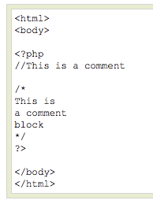
PHP Comments
In PHP, we use // to make a single-line comment or /* and */ to make a large comment block.

Slide 18

PHP Variables
> Variables are used for storing values, like text strings, numbers or arrays.
> When a variable is declared, it can be used over and over again in your script.
> All variables in PHP start with a $ sign symbol.
> The correct way of declaring a variable in PHP:

Slide 19

PHP Variables
> In PHP, a variable does not need to be declared before adding a value to it.
> In the example above, you see that you do not have to tell PHP which data type the variable is.
> PHP automatically converts the variable to the correct data type, depending on its value.

Slide 20
PHP Variables
> A variable name must start with a letter or an underscore "_" -- not a number
> A variable name can only contain alpha-numeric characters, underscores (a-z, A-Z, 0-9, and _ )‏
> A variable name should not contain spaces. If a variable name is more than one word, it should be separated with an underscore ($my_string) or with capitalization ($myString)‏

Slide 21
Variables in PHP
PHP variables must begin with a “$” sign
Case-sensitive ($Foo != $foo != $fOo)
Global and locally-scoped variables
Global variables can be used anywhere
Local variables restricted to a function or class
Certain variable names reserved by PHP
Form variables ($_POST, $_GET)
Server variables ($_SERVER)
Etc.

Slide 22
Variable usage
<?php
$foo = 25; // Numerical variable $bar = “Hello”; // String variable
$foo = ($foo * 7); // Multiplies foo by 7 $bar = ($bar * 7); // Invalid expression
?>

Slide 23
Using PHP Constants
> Constants are constant; that is, they can’t be changed by the script. After you set the value for a constant, it stays the same. If you used a constant for age and set it to 21, for example, the Value is always and forever 21.
> You set constants by using the define statement. The format is define(“constantname”,”constantvalue”);
For instance, to set a constant with the company name, use the following
Statement: define(“COMPANY”,”My Company”);
Another example: define (“AGE”,29);
> Constant names are not preceded by a dollar sign ($).
echo COMPANY; // output= My Company;
echo $COMPANY; // Undefined variable problem

Slide 24
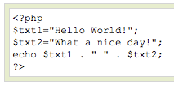
PHP Concatenation
> The concatenation operator (.) is used to put two string values together.
> To concatenate two string variables together, use the concatenation operator:

Slide 25

PHP Concatenation
The output of the code on the last slide will be:
If we look at the code you see that we used the concatenation operator two times. This is because we had to insert a third string (a space character), to separate the two strings.

Slide 26
Escaping the Character
If the string has a set of double quotation marks
that must remain visible, use the \ [backslash]
before the quotation marks to ignore and display
them.
<?php
$heading=“\”Computer Science\””;
Print $heading;
?>
“Computer Science”

Slide 27
PHP Operators
Operators are used to operate on values. There are four classifications of operators:
> Arithmetic
> Assignment
> Comparison
> Logical

Slide 28
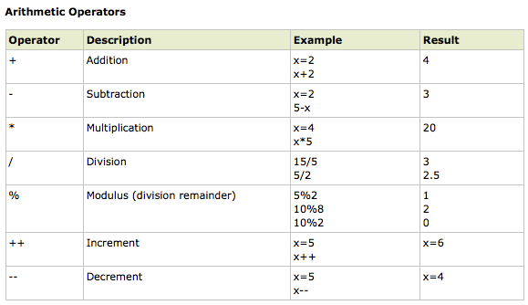
PHP Operators

Slide 29
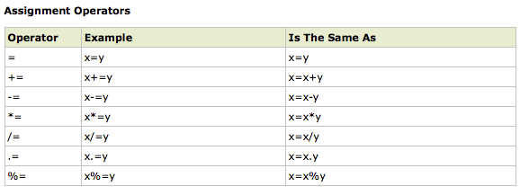
PHP Operators

Slide 30
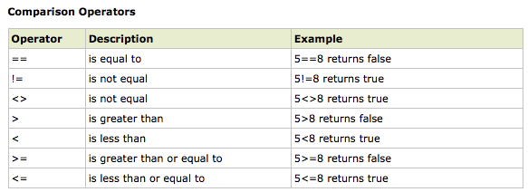
PHP Operators

Slide 31
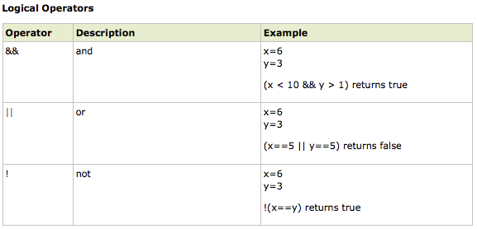
PHP Operators

Slide 32
PHP Conditional Statements
> Very often when you write code, you want to perform different actions for different decisions.
> You can use conditional statements in your code to do this.
> In PHP we have the following conditional statements...

Slide 33
PHP Conditional Statements
> if statement - use this statement to execute some code only if a specified condition is true
> if...else statement - use this statement to execute some code if a condition is true and another code if the condition is false
> if...elseif....else statement - use this statement to select one of several blocks of code to be executed
> switch statement - use this statement to select one of many blocks of code to be executed

Slide 34
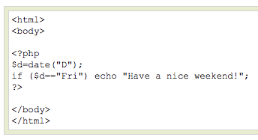
PHP Conditional Statements
The following example will output "Have a nice weekend!" if the current day is Friday:

Slide 35
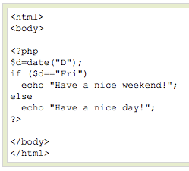
PHP Conditional Statements
Use the if....else statement to execute some code if a condition is true and another code if a condition is false.

Slide 36
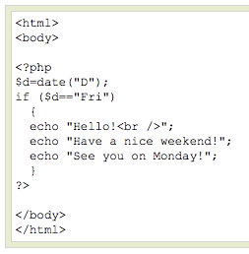
PHP Conditional Statements
If more than one line should be executed if a condition is true/false, the lines should be enclosed within curly braces { }

Slide 37
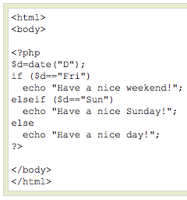
PHP Conditional Statements
The following example will output "Have a nice weekend!" if the current day is Friday, and "Have a nice Sunday!" if the current day is Sunday. Otherwise it will output "Have a nice day!":

Slide 38
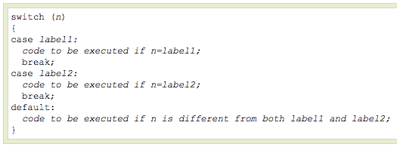
PHP Conditional Statements
Use the switch statement to select one of many blocks of code to be executed.

Slide 39
PHP Conditional Statements
For switches, first we have a single expression n (most often a variable), that is evaluated once.
The value of the expression is then compared with the values for each case in the structure. If there is a match, the block of code associated with that case is executed.
Use break to prevent the code from running into the next case automatically. The default statement is used if no match is found.

Slide 40
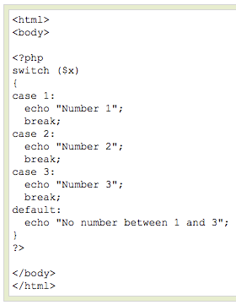
PHP Conditional Statements

Slide 41
END

